Slide 1


Enable Web Payments Using Google Pay
Ankit
SDE III, Cisco systems
India

Slide 2
What is Web Payments?
Web Payments is an emerging web standard being developed by the W3C to simplify online payments.
The standards are flexible; they work with various types of payment systems and are intended to work on any browser on any device, payment method, or payment service provider.

Slide 3
Benefits of Web Payments?
Simplified check out flow for consumers.
Easy to implement payment options for merchants.
They allow bringing any type of payment methods to the web with relatively easy integration for payment handlers.
They bring new payment methods for payment service providers.

Slide 4
The three principles of Web Payments?
Standard and Open
Easy and Consistent
Secure and Flexible

Slide 5
The Google Pay API

Slide 6
The Google Pay API
The Google Pay API facilitates fast and easy online purchases.
It offer a one-touch checkout experience to hundreds of millions of Google users who have their credit or debit card payment information saved in their Google accounts.
Supported web browsers: Google Chrome, Mozilla Firefox, Apple Safari, Microsoft Edge, Opera, and UCWeb UC Browser.

Slide 7
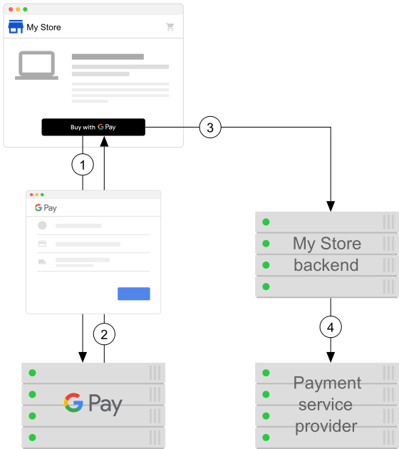
How it works?
User clicks the Google Pay payment button.
User selects a payment method.
Your website submits the payment token, along with details about the purchase, to its backend.
The backend processes the purchase.
Image source : https://developers.google.com/

Slide 8
Integrate the Google Pay API to
a web app

Slide 9
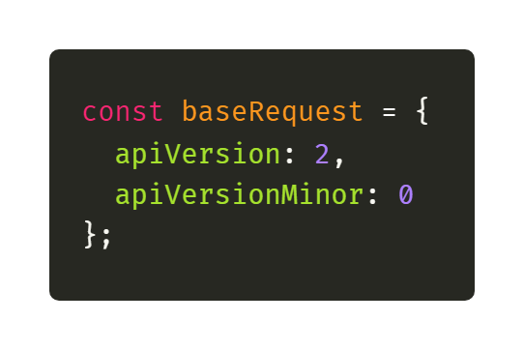
Step 1: Define your Google Pay API version

Slide 10
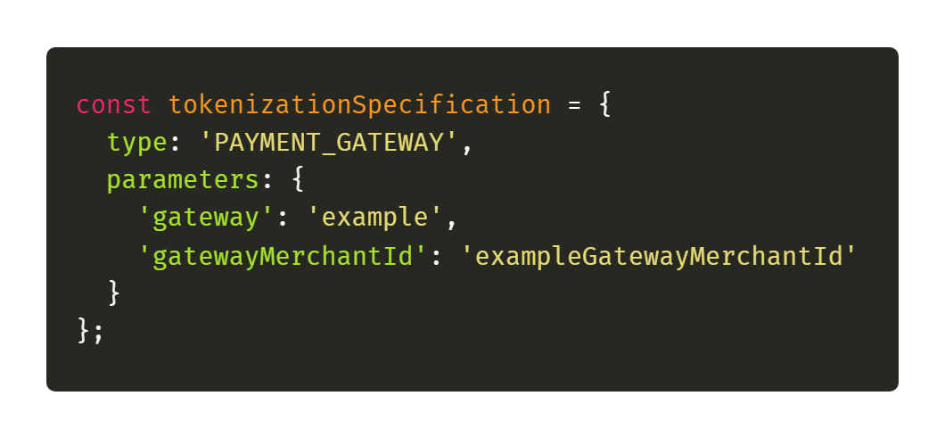
Step 2: Request a payment token for your payment provider

Slide 11
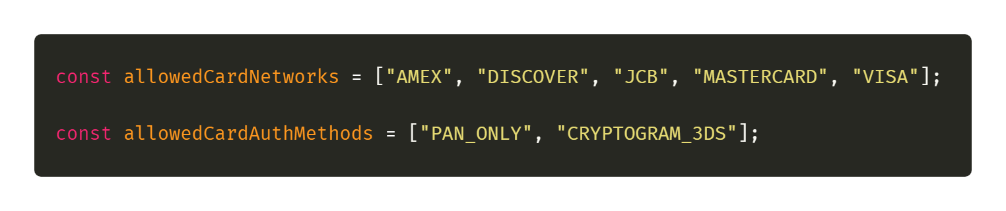
Step 3: Define supported payment card networks

Slide 12
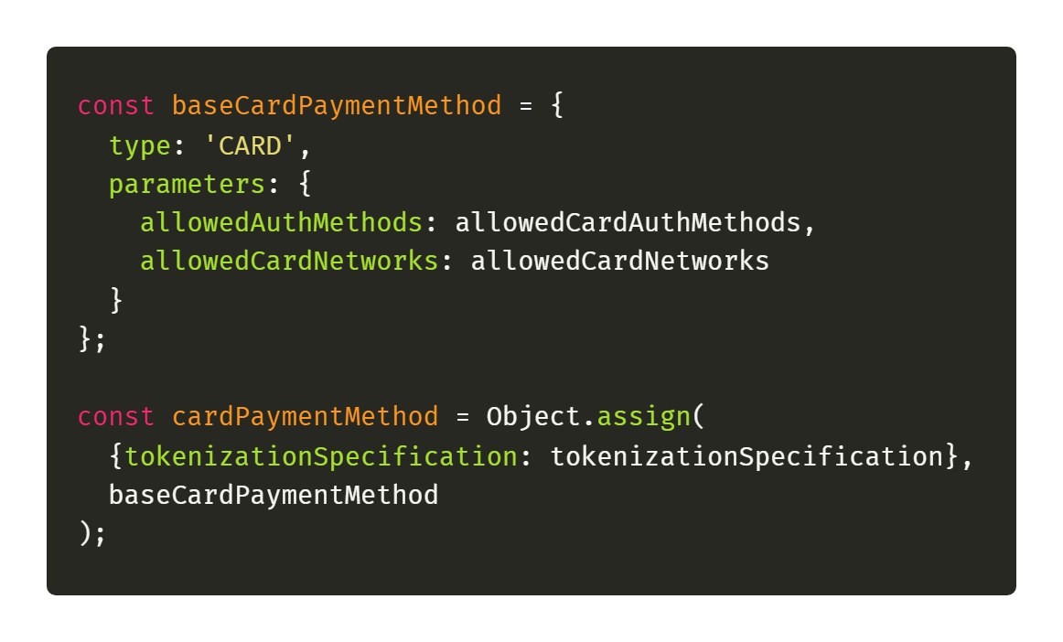
Step 4: Describe your allowed payment methods

Slide 13
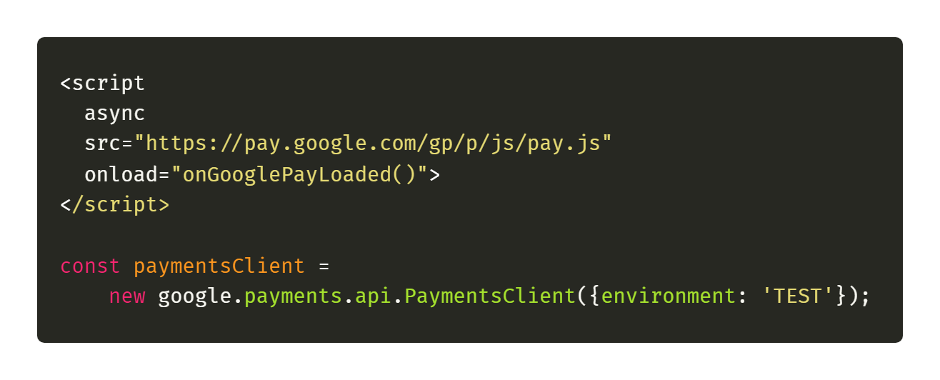
Step 5: Load the Google Pay API JavaScript library

Slide 14
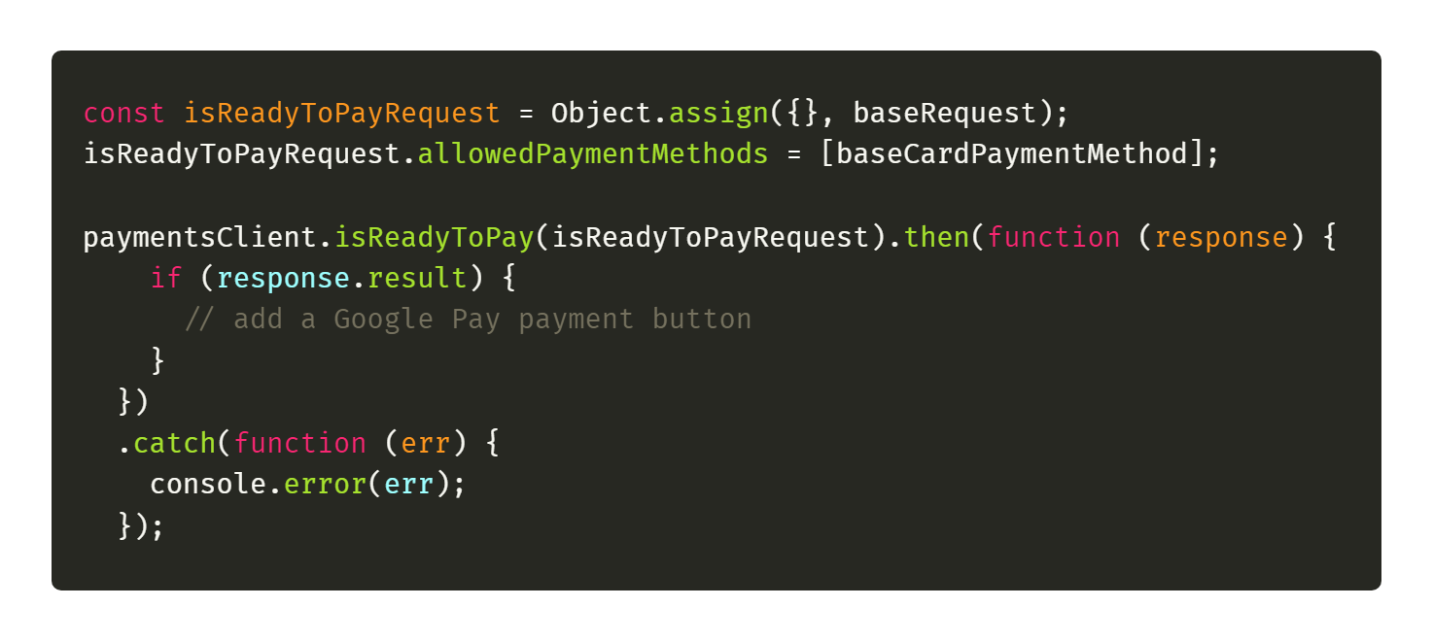
Step 6: Determine readiness to pay with the Google Pay API

Slide 15
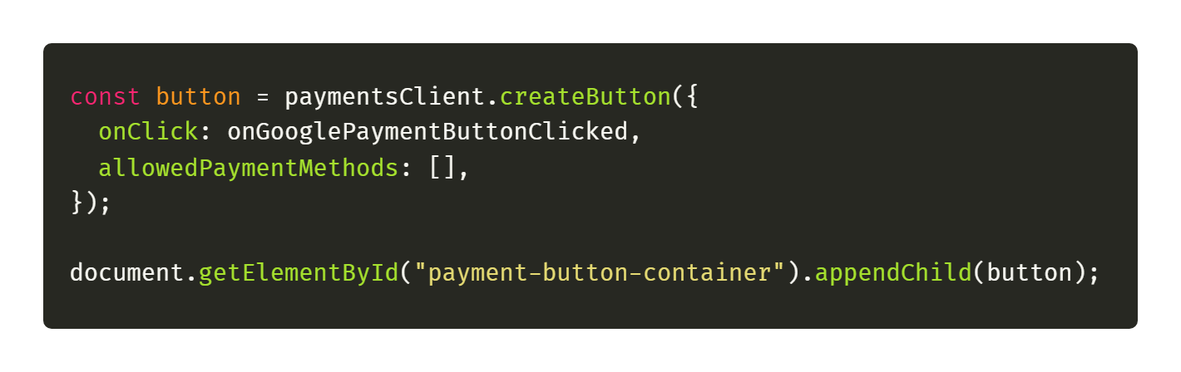
Step 7: Add a Google Pay payment button

Slide 16
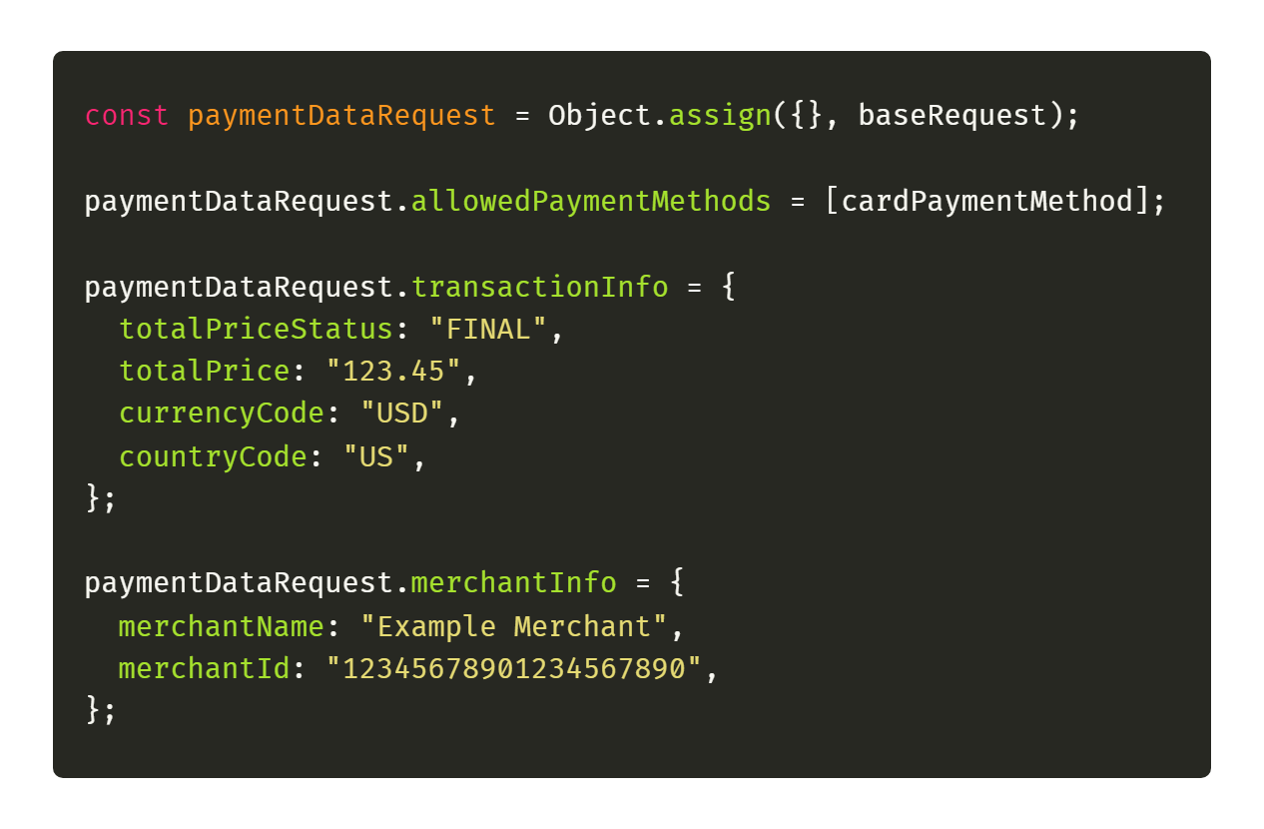
Step 8: Create a PaymentDataRequest object

Slide 17
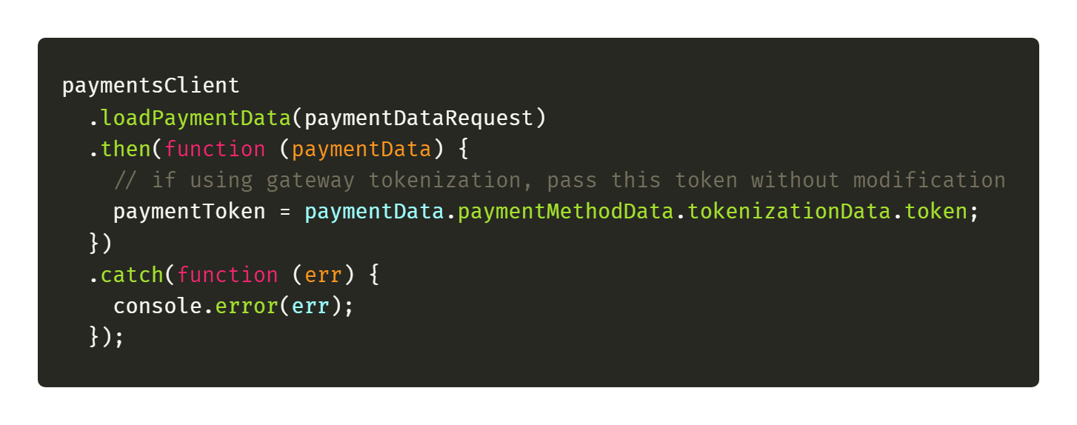
Step 9: Register an event handler for user gestures

Slide 18
Demo Time

Slide 19
Web Payments Interview questions
Why should we use web payments?
What are the three core principles of web payments?
What is the payment flow of the Google pay API?

Slide 20
ML & AR / VR Interview questions
What are the primary usage of TensorFlow.js?
How TensorFlow.js achieves good performance?
How we can use WebXR in browser?

Slide 21
Thank you for joining

